Slide 1

Session 11 (of 24)
PGR112 Objektorientert programmering
Yuan Lin / yuan.lin@kristiania.no

Slide 2
Today’s Main Goal
Collection – Set, List
Serialization
Equals
HashCode
Optional

Slide 3
Status
Step 1: IntelliJ, Git, Hello World
Step 2: Variable, Method, Data type, Scope, Control statement
Step 3: Class, Object, Scanner, Encapsulation
Step 4: Package, Import, Modifiers, Overload, ArrayList, Enums
Step 5: Scanner (cont.), Input validation, Debugger, Write test
Step 6: Exception handling, File I/O, Logger, Date/Time
Step 7: Inheritance, Aggregation, Super, Final
Step 8: Abstract
Step 9: Interface
Step 10: Polymorphism
Now: Collection, Optional, Equals, HashCode, Serialization, Validation…
…

Slide 4
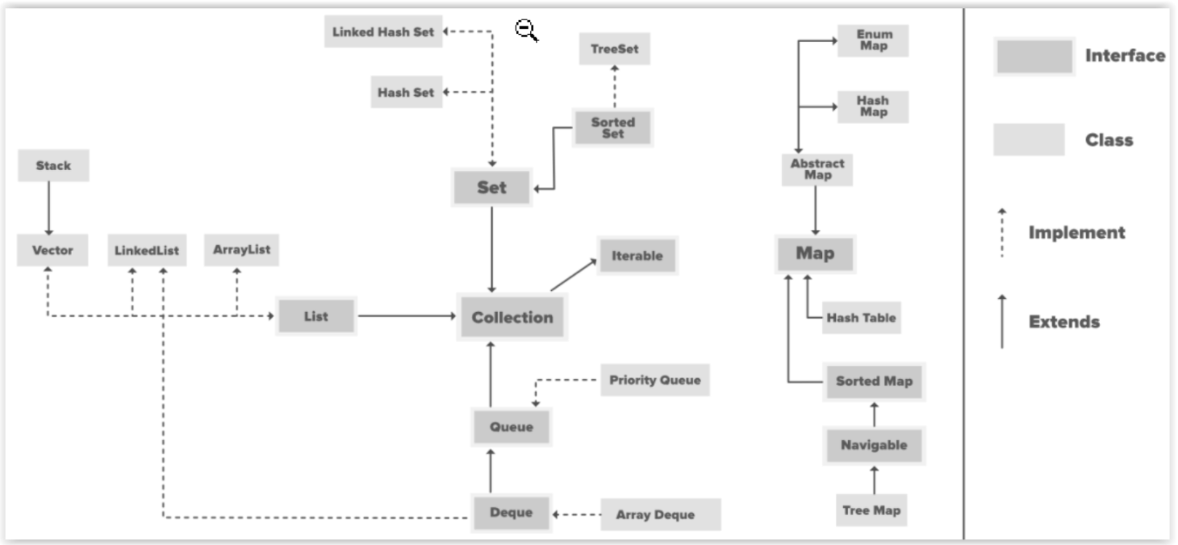
Collection (List, Set, etc…)
We will focus on List and Set. Queue is out of our lecture scope.
We have learned ArrayList, which is a subcategory of List.
We will introduce HashSet which is a subcategory of Set.
Src: geekforgeeks
Notes:
Any one can give more examples?

Slide 5
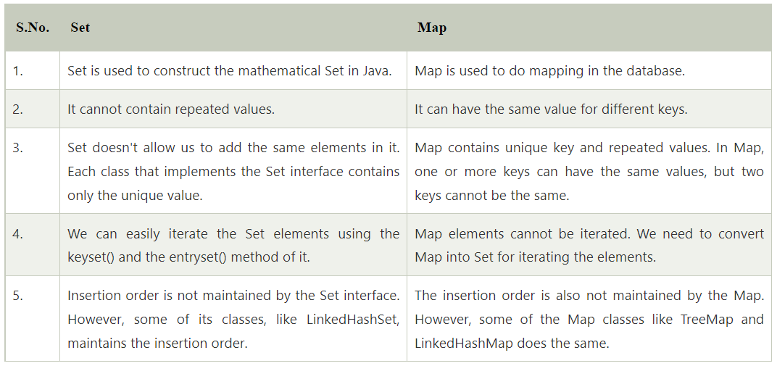
Collection (Set)
What is the difference between HashMap (Map) and Collection (Set)?
Both HashMap and Collection are interfaces in java.util package
Collection is used to store objects in Array format
Map is used to store objects in (key, value) pair format and hash
Src: javatpoint
Notes:
Any one can give more examples?

Slide 6
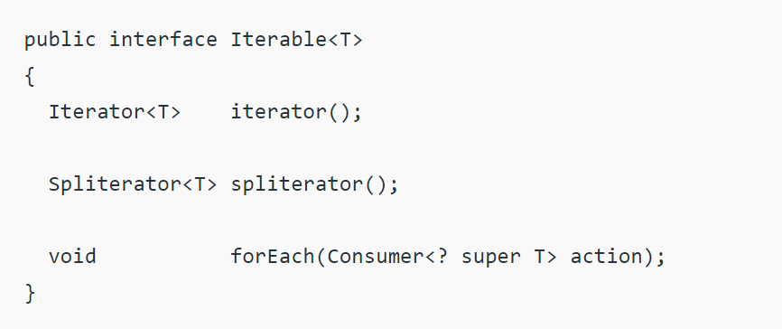
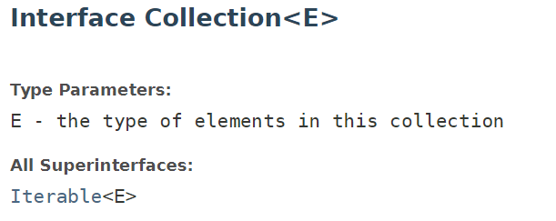
Iterable
Iterable interface belongs to java.lang package.
An object implementing Iterable allows it to be iterated.
Definition of Iterable (T is the type of element returned by the Iterator)
Collection implements Iterable interface
Src: geeksforgeeks
Notes:
Any one can give more examples?

Slide 7
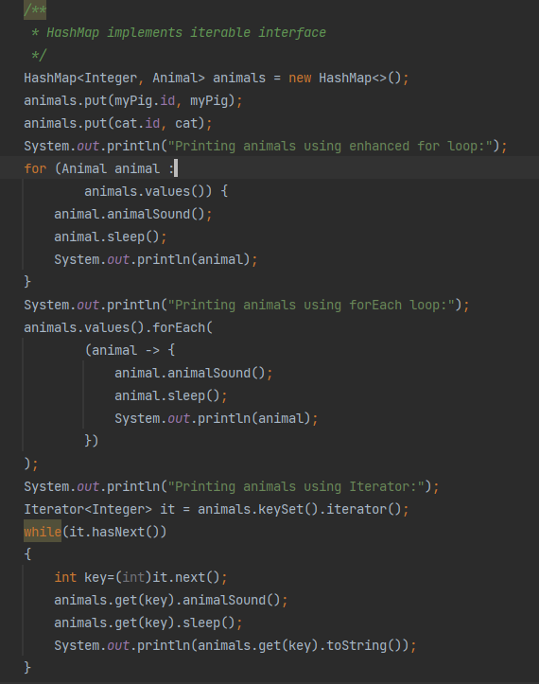
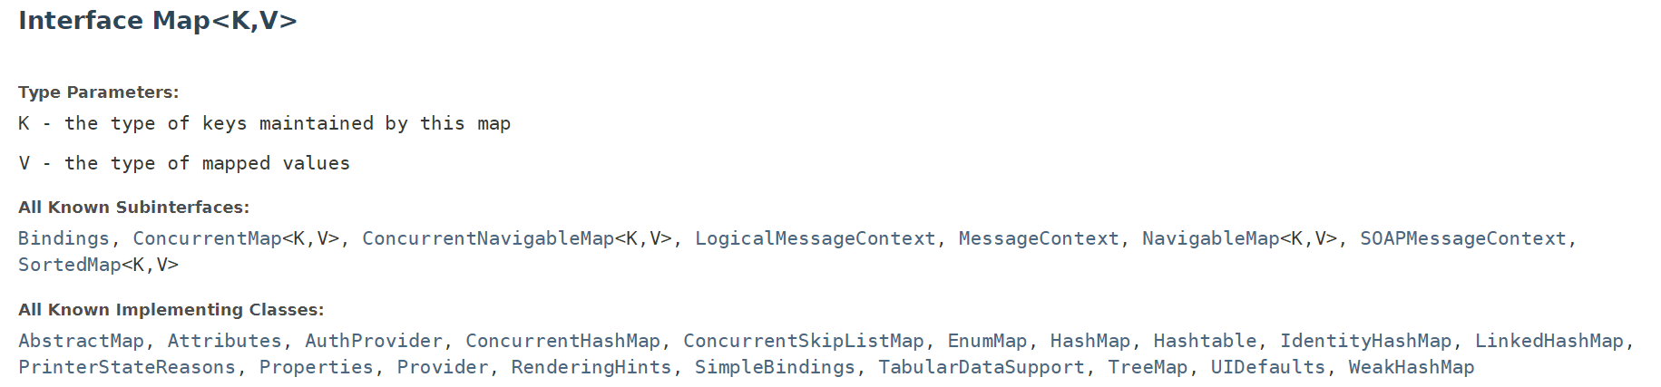
Iterable
Ways of iterating
Using enhanced for loop
Using Iterable forEach loop
Using Iterator<T> interface
Why can we use Iterable interface on the right? Map does not implement Iterable interface as Collection…
Animals.value() is java.util.Collection and animals.keyset() is java.util.Set, which both implement iterator interface by default.
Notes:
Any one can give more examples?

Slide 8
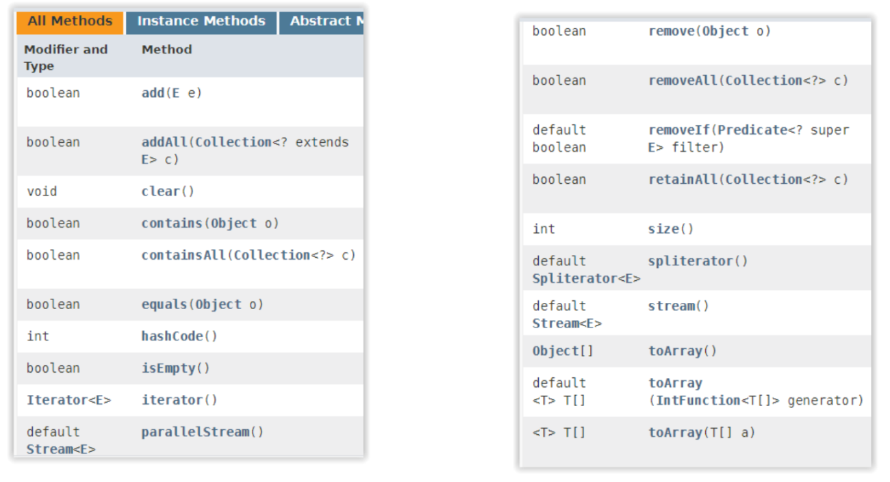
Collection methods
Notes:
Any one can give more examples?

Slide 9
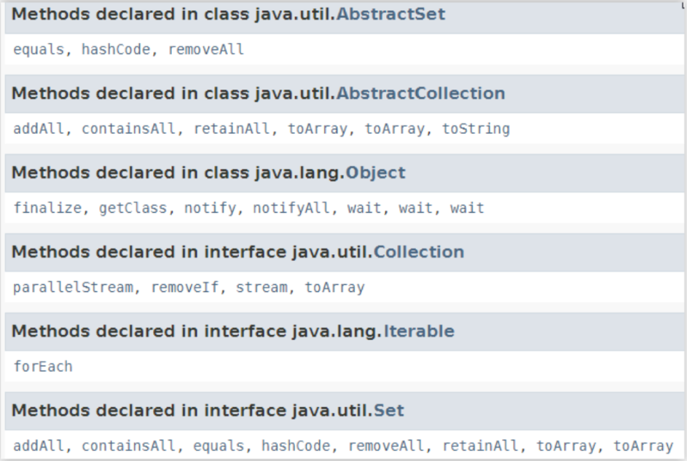
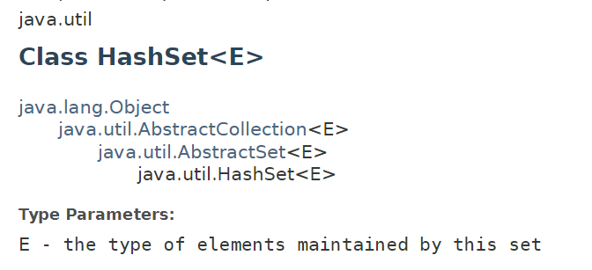
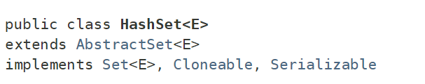
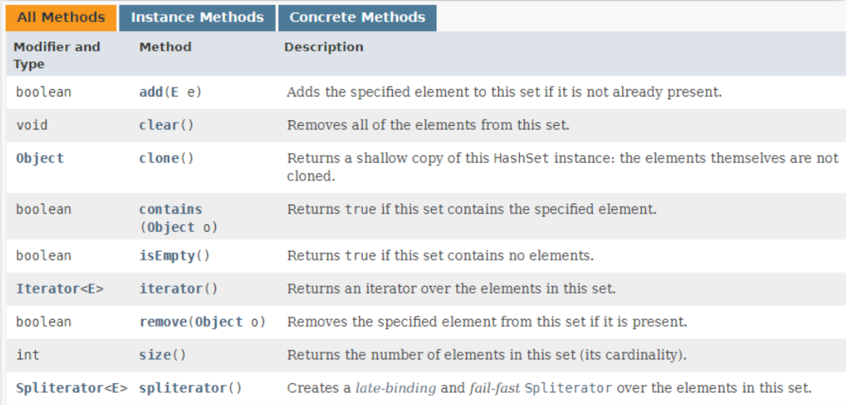
HashSet methods
Notes:
Any one can give more examples?

Slide 10
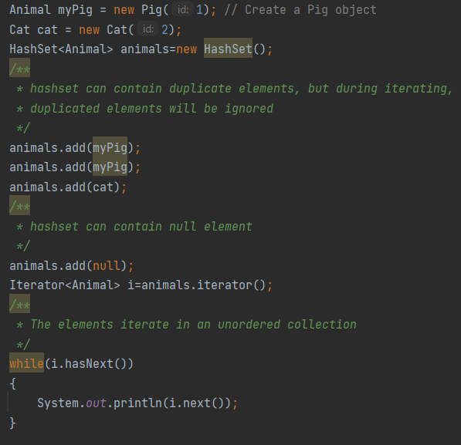
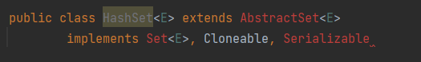
HashSet
Important facts about HashSet
HashSet implements Set interface, Set extends Collection, and Collection extends Iterable
HashSet stores elements by using hashcode
HashSet ignores duplicate elements
HashSet allows null value
HashSet does not maintain the insertion order. Elements are inserted on the basis of their hashcode
Difference between List & Set
List can contain duplicate element while Set does not
Declaration of HashSet
Notes:
Any one can give more examples?

Slide 11
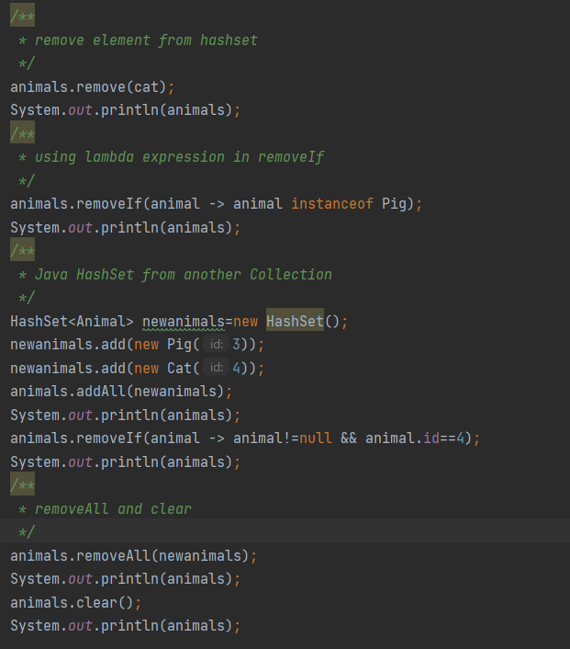
HashSet
The example on the right shows
Remove one element from HashSet
Using lambda expression in removeIf
Add HashSet from another Collection
Remove a collection from HashSet
Clear a HashSet
HashSet vs HashMap
HashSet does not contain key
HashSet does not allow duplicate value. HashMap allows duplicate values while not duplicate keys
Notes:
Any one can give more examples?

Slide 12
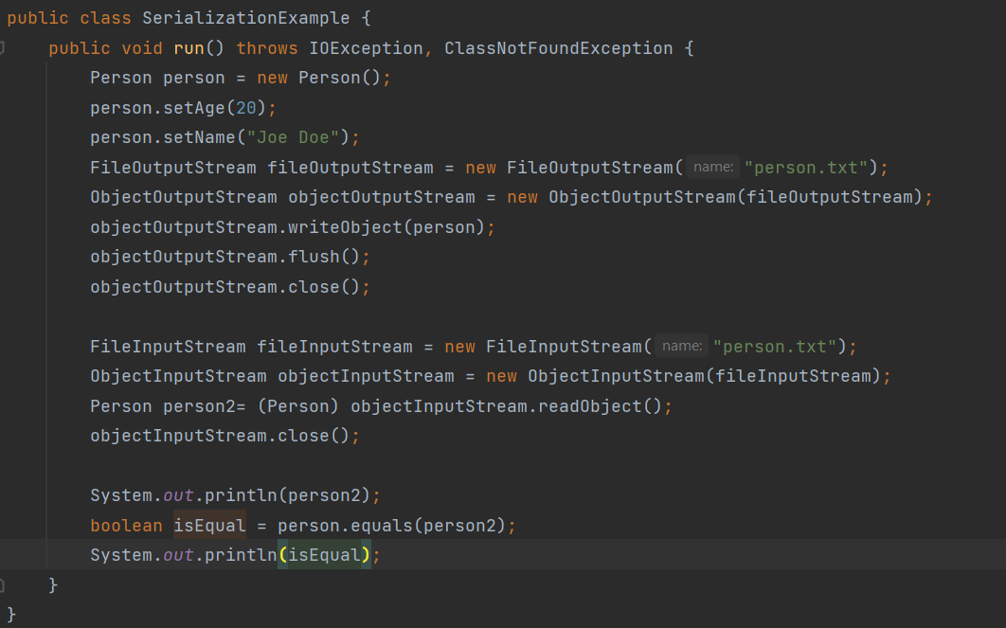
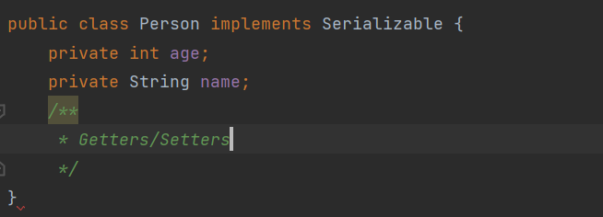
Serialization
What is Serialization?
Serialization converts an object to a byte stream, deserialization does the opposite. Class that are eligible for serialization needs to implement serializable interface.
All sub-class are serializable if the parent class implements serializable interface.
JVM associate a serial version UID with each serializable class
Why do we need serialization?
Store/fetch object cross-platform
Notes:
Any one can give more examples?

Slide 13
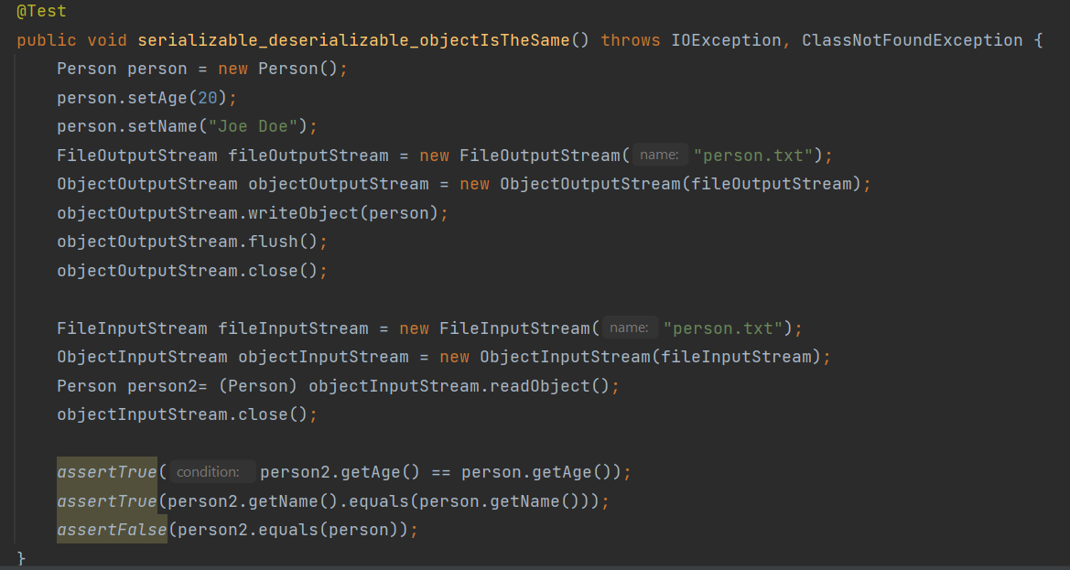
Equals
Let’s write an automation test
Why person2.equals(person) returns false? Aren’t they equal?
Notes:
Any one can give more examples?

Slide 14
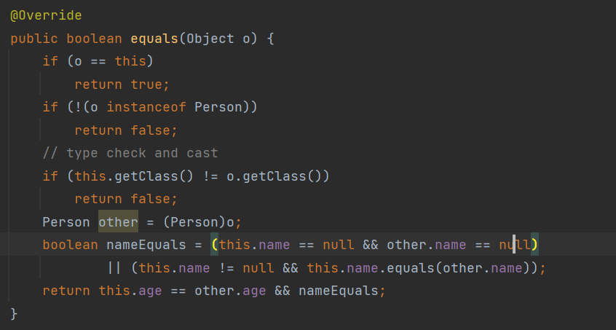
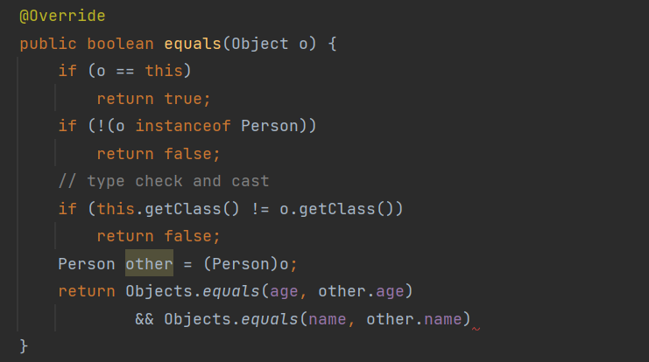
Equals
The object class defines both equals() and hashcode() – which means that these two methods are implicitly defined in every java class since all java class inherit object class.
The default implementation of equals() in object class says that equality is the same as object identity.
However, person2 and person are two distinct instances.
We need to override equals()!
The example on the right shows two methods of equals override.
Notes:
Any one can give more examples?

Slide 15
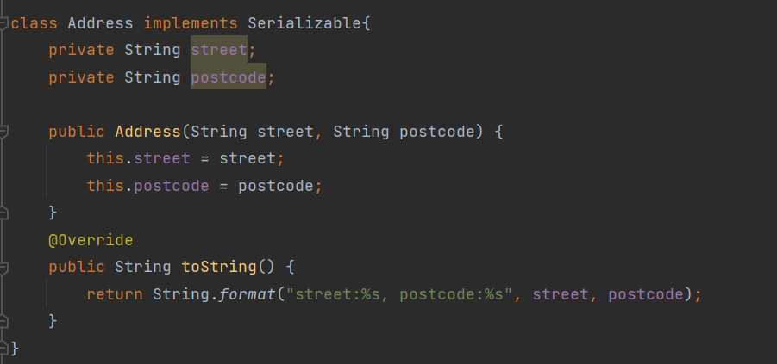
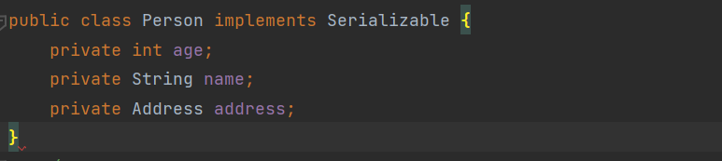
Equals
Think about aggregation case.
Notes:
Any one can give more examples?

Slide 16
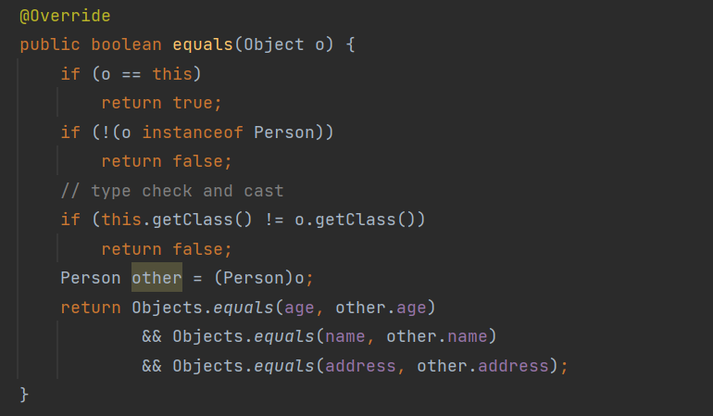
Equals
Will below code work?
Notes:
Any one can give more examples?

Slide 17
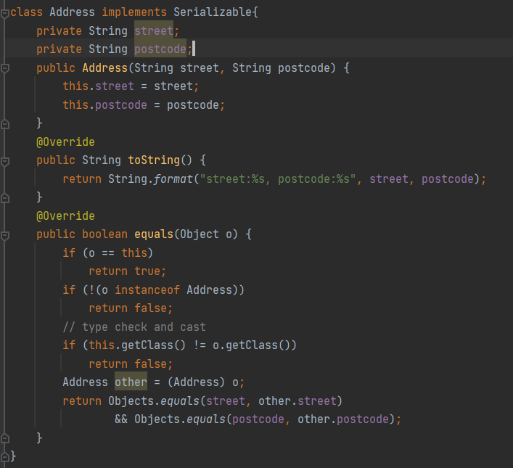
Equals
We need to implement equals() for the aggregated class as well
We can use
Object.equals(address, other.address)
Or
Address.equals(other.address)
Notes:
Any one can give more examples?

Slide 18
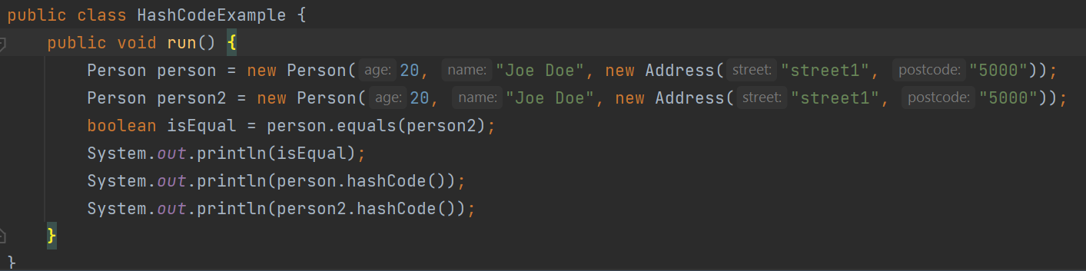
HashCode
hashCode() returns an integer representing the current instance of the class.
If we override the equals(), we also have to override hashCode(). Why?
Java SE defines a contract for hashCode(), which mentions 3 criteria between equals() and hashCode():
Internal consistency: the value of hashCode() may only change if a property in equals() changes
Equals consistency: objects that are equal to each other must return the same hashCode
Collisions: unequal objects may have the same hashCode
The 2nd criteria of hashCode contract indicates that: if we override equals(), we must also override hashCode()
What is the output here? – person and person2 end up with different hashCode.
Notes:
Any one can give more examples?

Slide 19
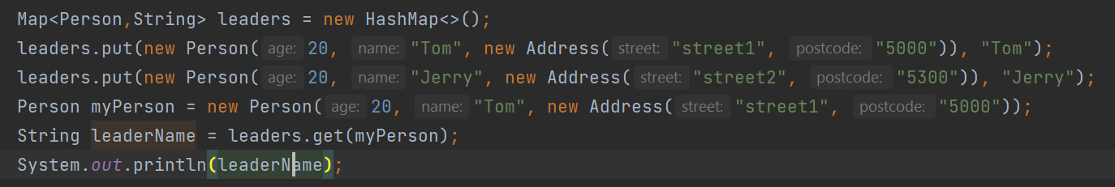
HashMap key with an inconsistent hashCode()
Why the violation of hashCode contract 2nd criteria?
Let’s take below example. You would expect it returns Tom.
But it isn’t. Why? Because we didn’t override hashCode. myPerson ends up with a different hashCode. When using this hashCode to search hashMap, it hits null.
Notes:
Any one can give more examples?

Slide 20
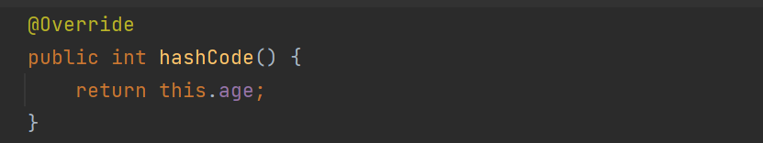
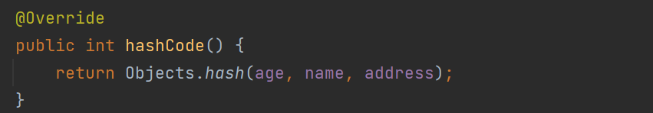
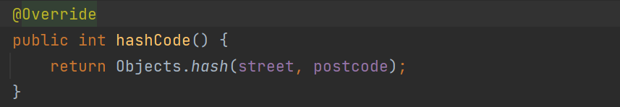
Override HashCode
There are many different ways of overriding hashCode()
Can we do this?
We need to override hashCode of class Address too!
Let’s rerun the program. We get Tom successfully.
Notes:
Any one can give more examples?

Slide 21
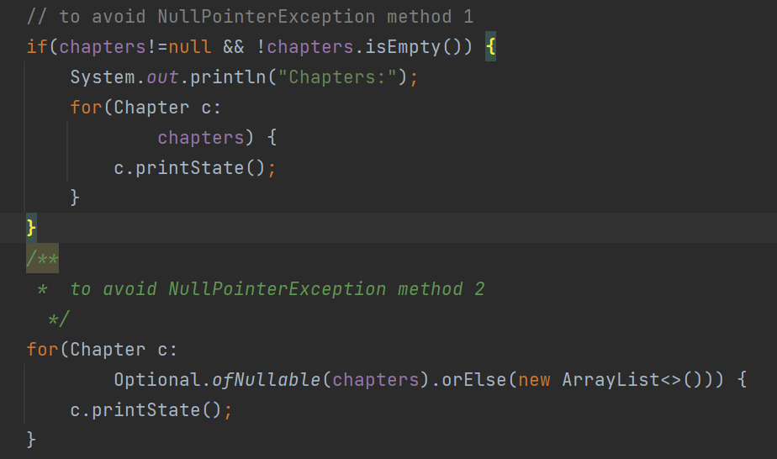
Optional
What is Optional? In Session 4, we introduced the code on the right.
Java 8 documentation says that am Optional is “A container object which may or may not contain a non-null value. If the value is present, isPresent() will return true and get() will return the value”
Why is it useful in practice?
Optional helps you deal with nullable values explicitly as a way of enforcing good programming practices.
By wrapping the object into an Optional object, implicit validation will be performed as well as executing the code.
Notes:
Any one can give more examples?

Slide 22
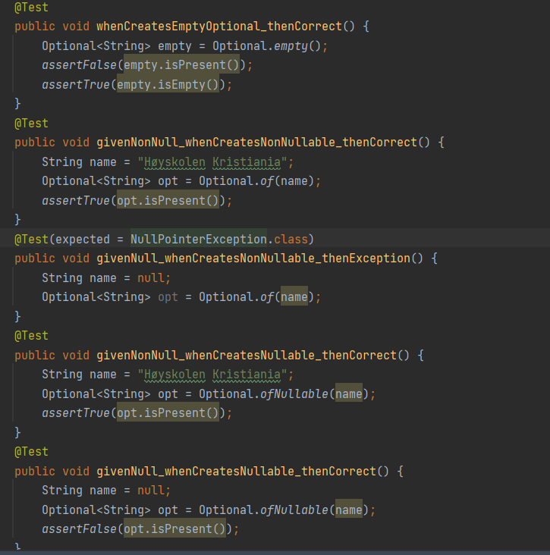
Optional
Creating Optional Objects
Use empty() static method to create an empty Optional object
Use of() static method to create an non-empty Optional object. The argument passed to the of() can’t be null. Otherwise NullPointerException will be thrown.
Use ofNullable() static method to create an Optional object in case we expect some null values.
Note that the third test throws NullPointerException
Notes:
Any one can give more examples?

Slide 23
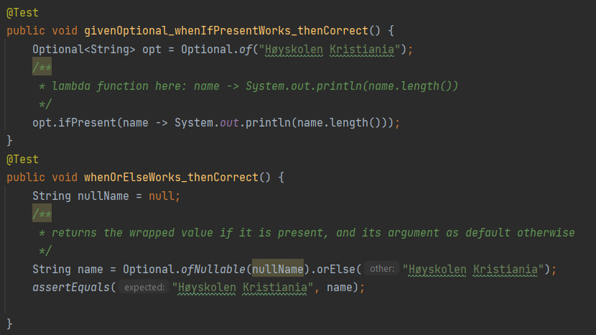
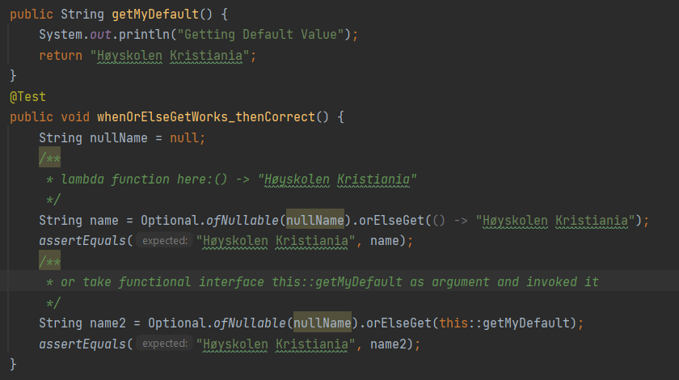
Optional – checking value presence
isEmpty(): is used to check if there is a value in the created Optional object
isPresent(): is used to check if there is a value in the created Optional object
Conditional ifPresent(): using Lambda function to run code on the wrapped value if it’s found to be non-null.
orElse(): returns the wrapped value if it is present, and its argument as default otherwise.
orElseGet(): take a functional interface instead of a value as argument.
Notes:
Any one can give more examples?

Slide 24
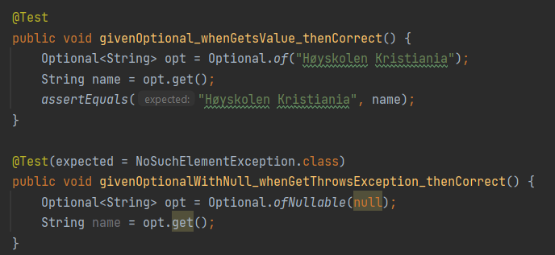
Optional – return value
get(): is used to retrieve the wrapped value.
get() can only return a value if the wrapped object is not null. Otherwise it throws NoSuchElementException
Notes:
Any one can give more examples?

Slide 25
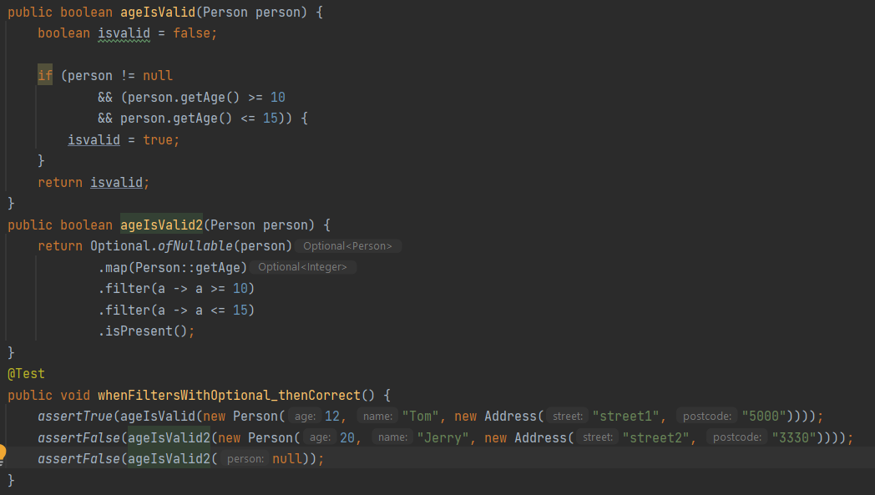
Optional – conditional return value
filter() is normally used to reject wrapped values based on a predefined rule.
The map call here is used to transform a value to some other value.
They are all lambda functions.
Notes:
Any one can give more examples?

Slide 26
Before we end
Goals for this session:
I know Collection (Set, List, HashSet)
I know Serialization and Serializable interface
I know why and how to override equals() and hashCode()
I know why and how to use Optional
Remember, do not just read code, play with it. Good luck with the tasks! Remember, there is help available all week, use Mattermost or GitHub.

